Slide 1
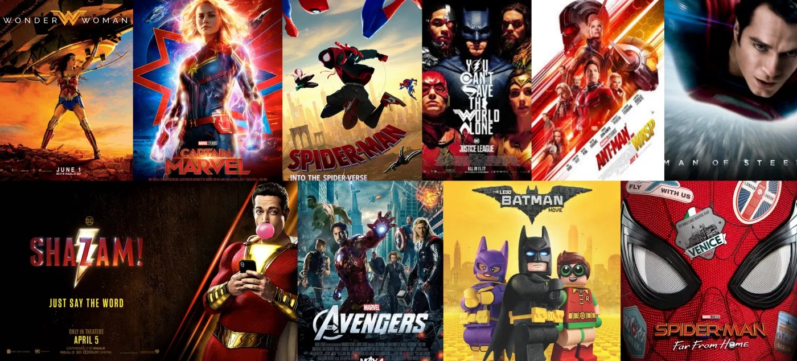
Movie recommendation system
GANESH SAINI
2021MSCS004
INDRAJIT CHAKRABORTY 2021MSCS005

Slide 2
TABLE OF CONTENTs
Recommendation system
Application
Types of recommendation system
Work flow
TF-IDF vectorizer & cosine similarity
Sample output
Conclusion and Application

Slide 3

RECOMMENDATION SYSTEM
Recommendation system captures the pattern of people’s behaviour and uses it to predict what else they might want or like.

Slide 4


Where is recommendation system used
• What to buy ?
• E - commerce , books , movies , beer ,shoes
• Where to eat ?
• Which job to apply to ?
• Who you should be friends with ?
• LinkedIn , Facebook , ...
Personalize your experience on the web
• News platforms, news personalization

Slide 5
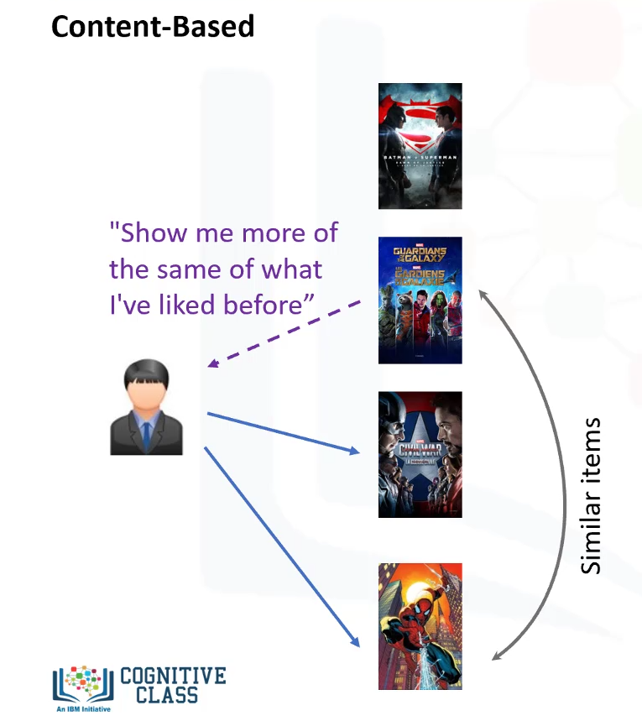
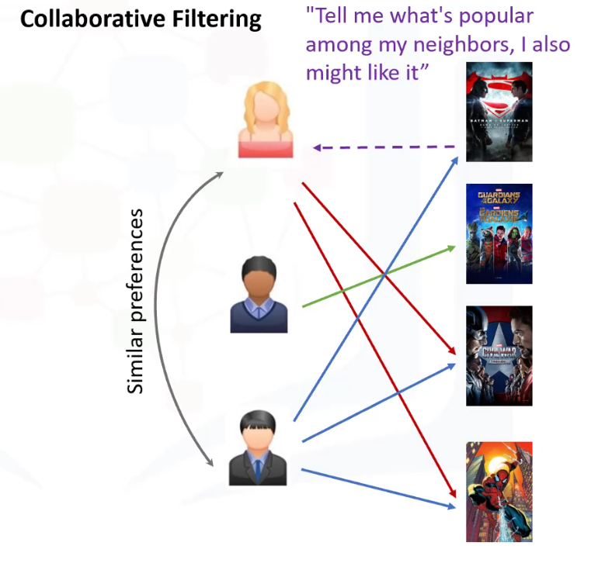

TYPES OF movie RECOMMENDATION SYSTEM

Slide 6
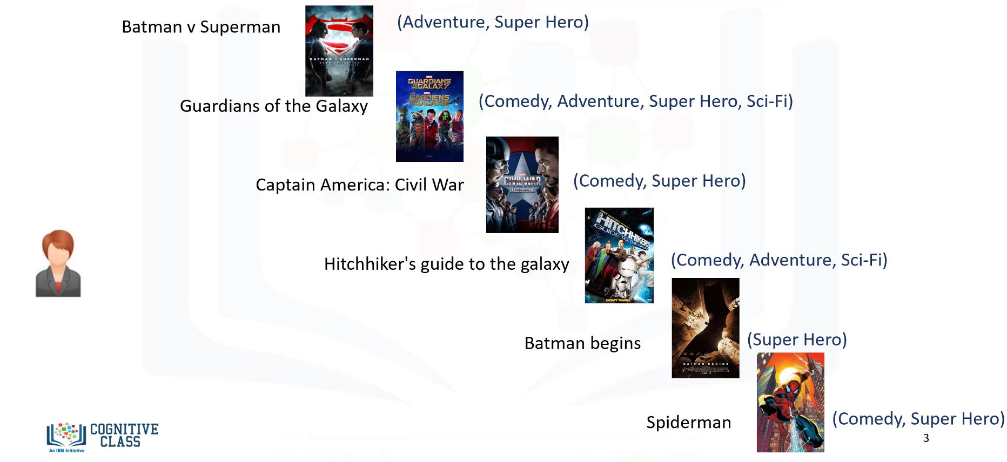

CONTENT-BASED RECOMMENDATION SYSTEM

Slide 7
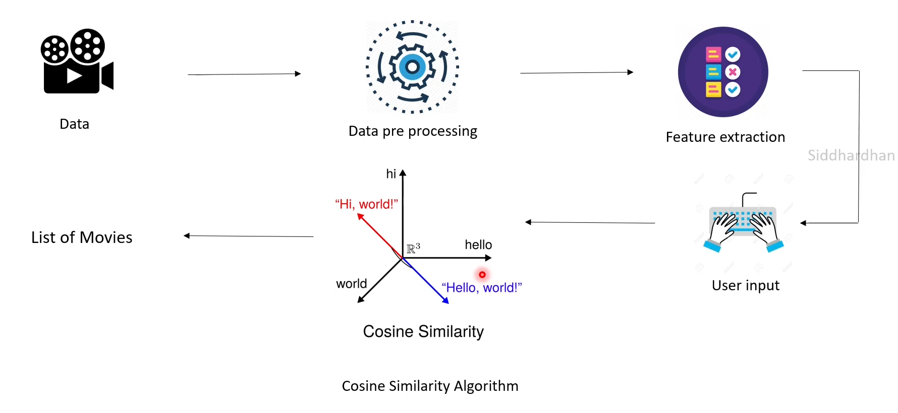


WORK-FLOW

Slide 8
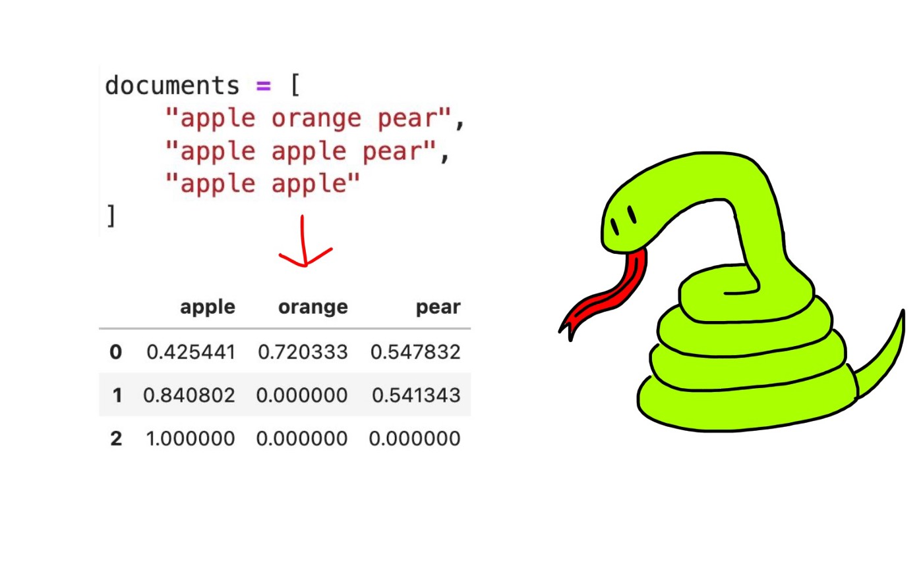
Feature Extraction: The mapping from textual data to real-valued vectors is called feature extraction.
Term Frequency - Inverse Document Frequency ( TF - IDF ) : To count the number of times each word appears in a Document
TF-IDF VECTORIZER
Term Frequency ( TF ) = ( Number of times term t appears in a document ) / ( Number of terms in the document )
Inverse Document Frequency ( IDF ) = log ( N / n ), where, N is the number of documents and n is the number of documents a term t has appeared in.
The IDF value of a rare word is high, whereas the IDF of a frequent word is low.
TF - IDF value of a term = TF x IDF

Slide 9
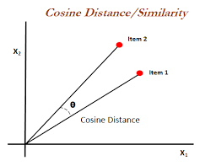
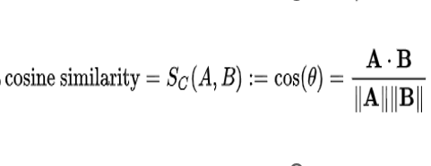
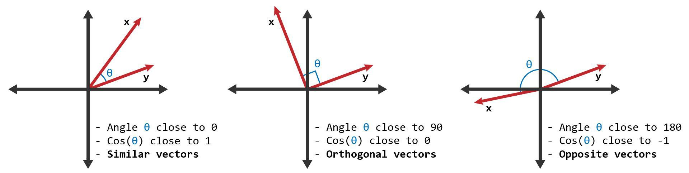
COSINE SIMILARITY
MEMORY - BASED
Uses the entire user - item dataset to generate a recommendation .
Uses statistical techniques to approximate users or items
e.g. Cosine Similarity , Euclidean Distance.
Cosine Similarity is a measurement that quantifies the similarity between two or more vectors. The cosine similarity is the cosine of the angle between vectors.
The cosine similarity is described mathematically as the division between the dot product of vectors and the product of their length.

Slide 10
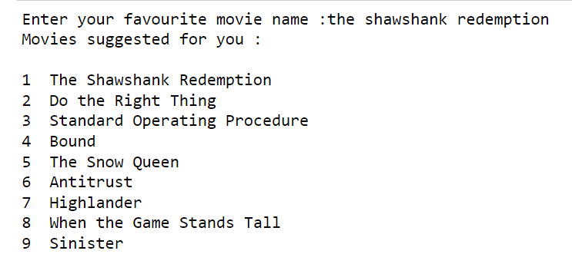
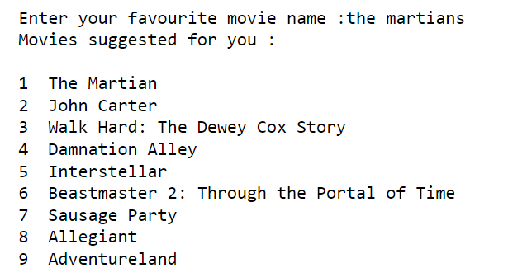
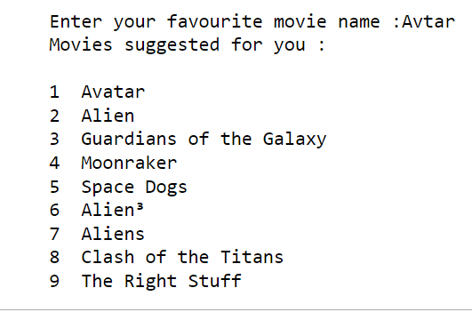
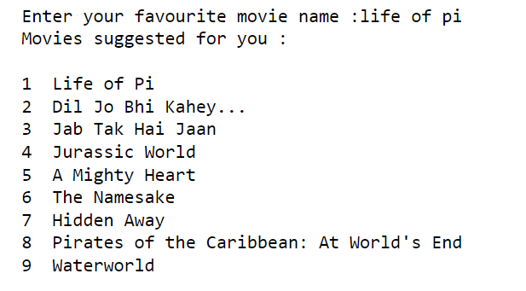
Sample outputs

Slide 11
Conclusion and application
According to the result we can observe that this movie recommendation system is capable of recommending similar movies as the input movies name.
This movie recommendation systems can be used in different streaming services. It can be also used in movie recommendation websites

Slide 12
THANK YOU
Lights
Camera
Action

